Slide 1

MULTITHREADING and NETWORK PROGRAMMING

Slide 2
Concepts of Network Programming
Python provides two levels of access to network services.
At a low level, you can access the basic socket support in the underlying operating system, which allows you to implement clients and servers for both connection-oriented and connectionless protocols.

Slide 3
Python also has libraries that provide higher-level access to specific application-level network protocols, such as FTP, HTTP, and so on.

Slide 4
Socket Programming.
Sockets are the endpoints of a bidirectional communications channel. Sockets may communicate within a process, between processes on the same machine, or between processes on different continents.

Slide 5
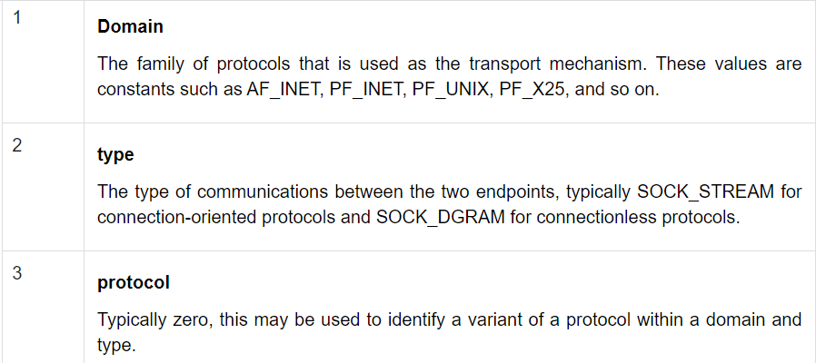

Slide 6
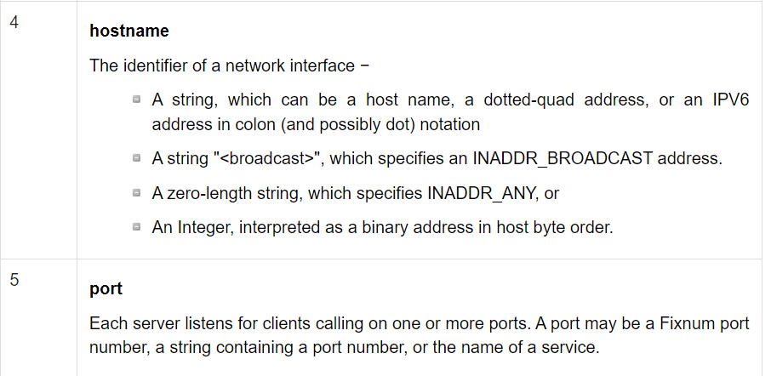

Slide 7
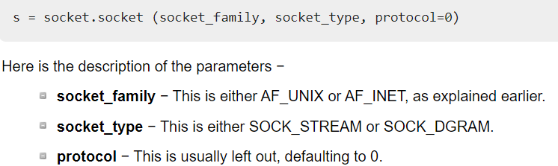
The socket Module

Slide 8
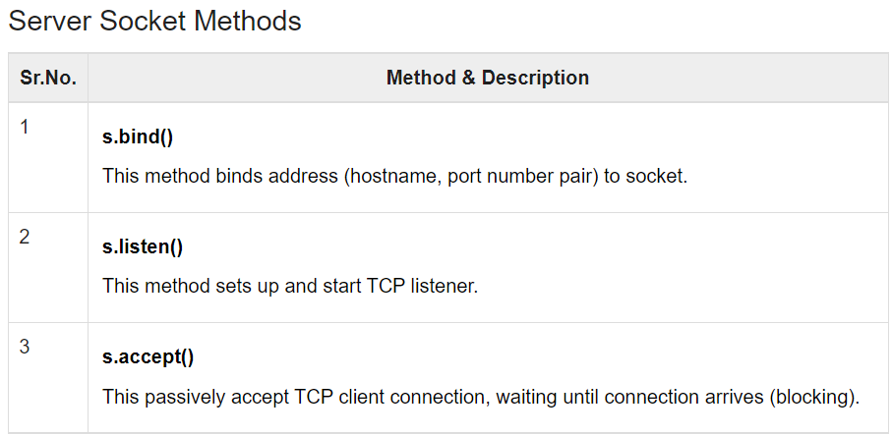

Slide 9
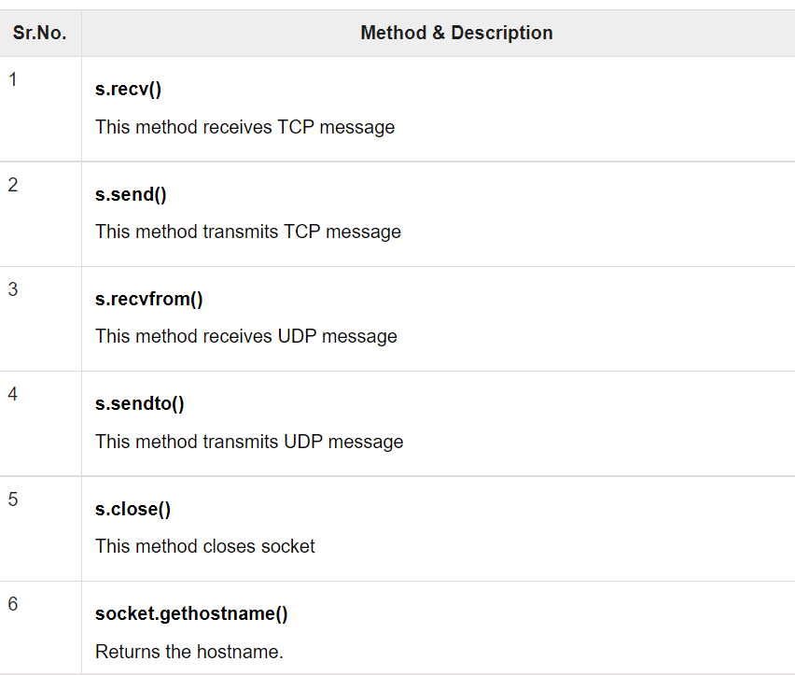
General Socket Method

Slide 10
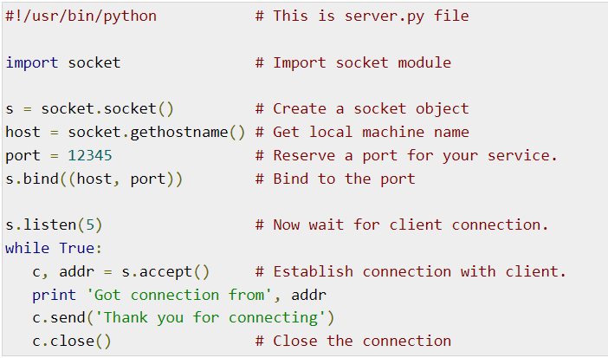
A Simple Server
To write Internet servers, we use the socket function available in socket module to create a socket object. A socket object is then used to call other functions to setup a socket server.

Slide 11
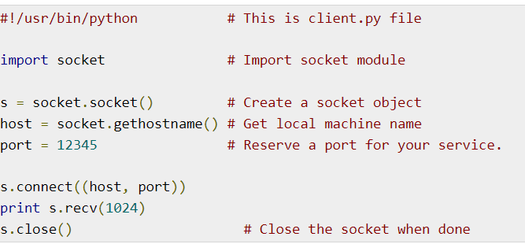
A Simple Client

Slide 12
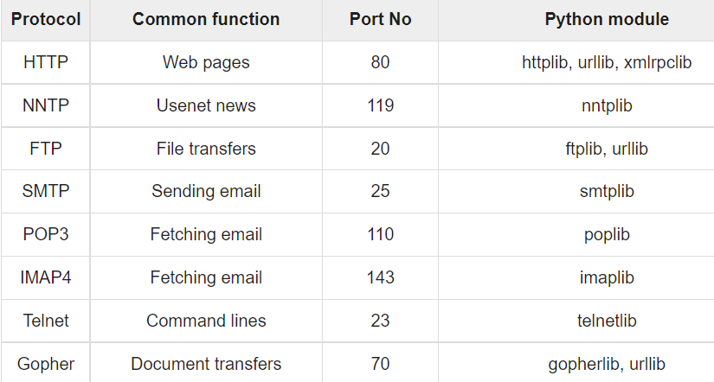
Python Internet modules

Slide 13
REST Architecture
REST stands for REpresentational State Transfer and API stands for Application Program Interface.
REST is a software architectural style that defines the set of rules to be used for creating web services.

Slide 14
A Restful system consists of a:
client who requests for the resources.
server who has the resources.

Slide 15
Architectural Constraints of RESTful API: There are six architectural constraints which makes any web service are listed below:
Uniform Interface
Stateless
Cacheable
Client-Server
Layered System
Code on Demand

Slide 16
Uniform Interface: It is a key constraint that differentiate between a REST API and Non-REST API. It suggests that there should be an uniform way of interacting with a given server irrespective of device or type of application (website, mobile app).
There are four guidelines principle of Uniform Interface are:
Resource-Based: Individual resources are identified in requests. For example: API/users.
Manipulation of Resources Through Representations: Client has representation of resource and it contains enough information to modify or delete the resource on the server, provided it has permission to do so. Example: Usually user get a user id when user request for a list of users and then use that id to delete or modify that particular user.
Self-descriptive Messages: Each message includes enough information to describe how to process the message so that server can easily analyses the request.
Hypermedia as the Engine of Application State (HATEOAS): It need to include links for each response so that client can discover other resources easily.

Slide 17
Stateless: It means that the necessary state to handle the request is contained within the request itself and server would not store anything related to the session. In REST, the client must include all information for the server to fulfill the request whether as a part of query params, headers or URI.

Slide 18
Cacheable: Every response should include whether the response is cacheable or not and for how much duration responses can be cached at the client side. Client will return the data from its cache for any subsequent request and there would be no need to send the request again to the server.

Slide 19
Client-Server: REST application should have a client-server architecture. A Client is someone who is requesting resources and are not concerned with data storage, which remains internal to each server, and server is someone who holds the resources and are not concerned with the user interface or user state.

Slide 20
Layered system: An application architecture needs to be composed of multiple layers. Each layer doesn’t know any thing about any layer other than that of immediate layer and there can be lot of intermediate servers between client and the end server.
Code on demand: It is an optional feature. According to this, servers can also provide executable code to the client.

